Slide 1
Healthiest Lifestyles per City

Slide 2
Introduction
This study looks at the top healthiest cities and tries to determine what makes them healthy. Specifically, it looks at obesity levels, levels of sunshine each city gets, the cost of a bottle of water, the number of outdoor activities each city has, and the average number of hours a person works.

Slide 3
Variables Used for Analysis
SunshinePerDay: The average number of hours of sunshine a city gets
obesity_levels: Levels of obesity per country
water_cost: The accost of a bottle of water per city
outdoor_activity: The number of outdoor activities a city has
WorkPerDay: The average number of hours individuals work per day in each city
pollution: The pollution index score per city
life_expectancy: The life expectancy in years per country.

Slide 4
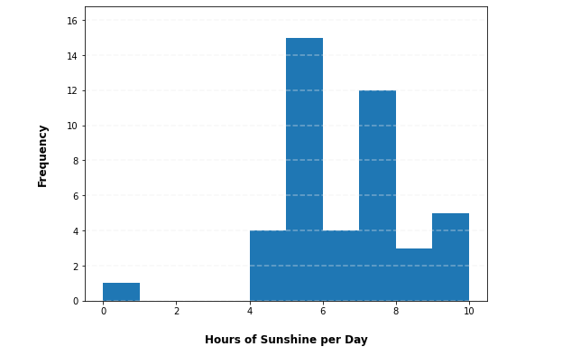
Analysis: Number of hours of Sunshine per Day per City
Mean: | 6.11 hrs
Median: | 6 hrs
Mode: | 5 hrs
Spread: | 0 hrs – 10 hrs
Outliers: 2 at 0 and 10 hrs
Since a city rarely has 0 hrs of sunshine, we can safely remove those cities.
Cities with 10 hrs of sunshine can happen so those cities will remain

Slide 5
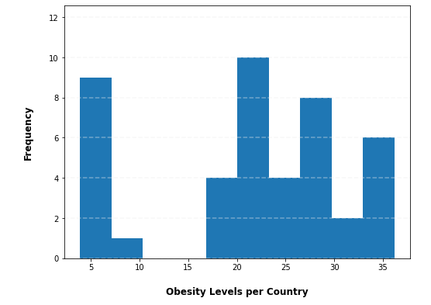
Analysis: Obesity Levels per Country
Mean: | 21.93
Median: | 22.3
Mode: | 36.2
Spread: | 3.9 – 36.2
Outliers: 4 outliers from levels 3.9 – 4.7
The levels seem to be far from the mean so we can safely remove them but there can be cities with very low obesity levels so keeping them wouldn’t be out of the question

Slide 6
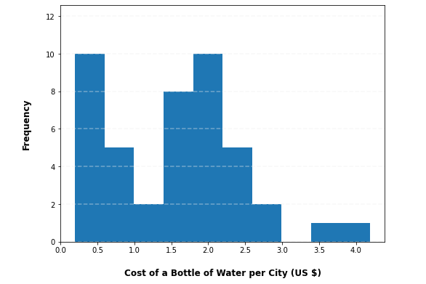
Analysis: Cost of a Bottle of Water (US $)
Outliers: 1 at $ 4.19
Mean: | $ 1.54
Median: | $ 1.57
Spread: | $ 0.20 - $ 4.19
There is one outlier of $4.19 for a bottle of water. Since the mean is $1.52 I this we can be safe to remove this outlier and just a very expensive city

Slide 7
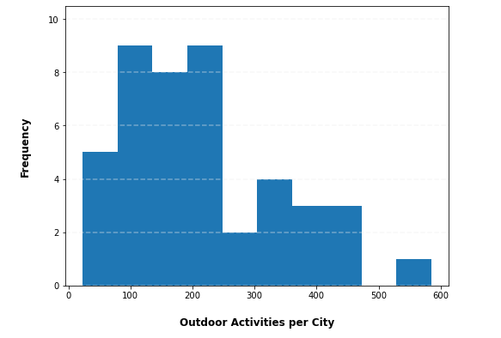
Analysis: Outdoor Activities per City
Mean: | 213.98
Median: | 189.5
Mode: | 223
Spread: | 23 - 585
Outliers: 1 at 585 activities
There is 1 outlier having a whopping 585 outdoor activities. As the mean is 214, I think we can safely remove this one city

Slide 8
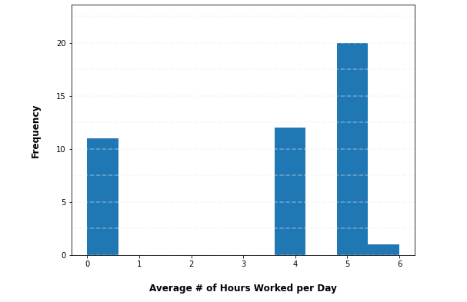
Analysis: Average # of Hours Worked per Day
Mean: | 3.5 hrs
Median: | 4 hrs
Mode: | 5 hrs
Spread: | 0 – 6 hrs
Outliers: 11 at 0 hrs
A lot of the cities has 0 daily hours of work but since this is an average this needs to stay in the dataset

Slide 9
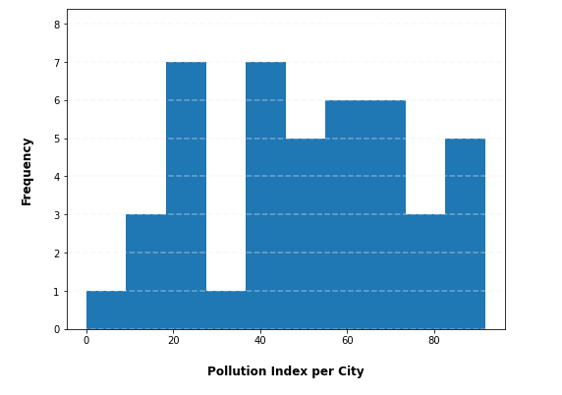
Analysis: Pollution Index Score per City
Mean: | 49.96
Median: | 50.98
Spread: | 0 – 91.74
Outliers: none

Slide 10
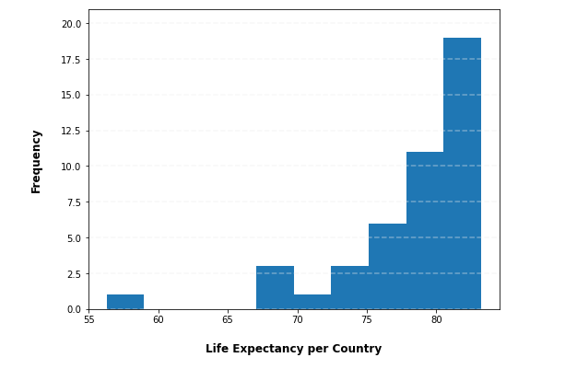
Analysis: Life Expectancy in Years per Country
Mean: | 78 years
Median: | 80 years
Mode: | 79 years
Spread: | 56 – 73 years
Outliers: 1 at 56.3 years
With life expectancy, I think we should keep this as the country may not live as long as others.

Slide 11
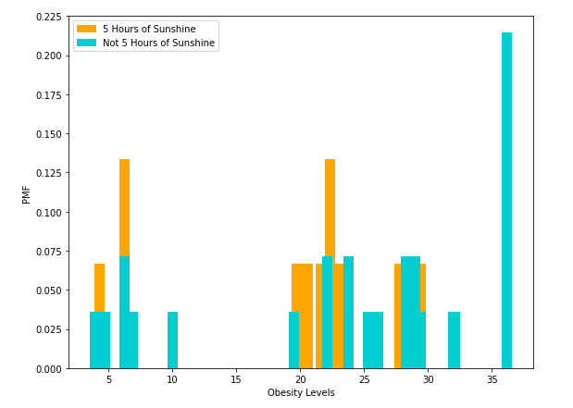
Compare Obesity Levels to the Average Number of Hours of Sunshine per Day per City
Mean obesity level with 5 hours of sunshine: 19.07
Mean obesity level with the rest: 23.54
As you can see, with the mode of 5 hours of sunshine, the obesity level is lower than the rest.

Slide 12
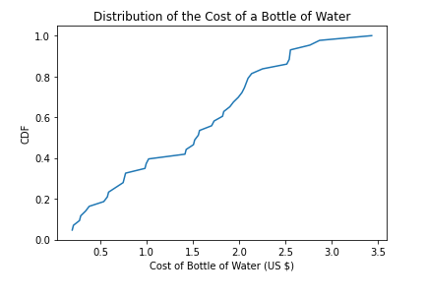
CDF: Cost of a Bottle of Water
About half the time, in the healthiest cities a bottle of water will cost $ 1.56.

Slide 13
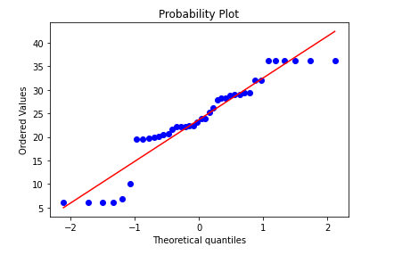
Probability Plot: Obesity Levels
The probability plot suggests that the distribution of Obesity weights shows levels near a normal distribution. The lower and upper levels or more skewed than the others

Slide 14
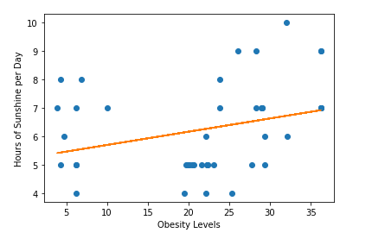
Obesity Levels vs Number of Hours of Sunshine per Day
The scatterplot shows that there is a weak positive correlation between obesity levels and the number of hours of sunshine per day. A low Pearson’s coefficient and R-squared also indicate this
Pearson’s Correlation:
Correlation = 0.40
p-value = 0.001
R-squared: 0.09

Slide 15
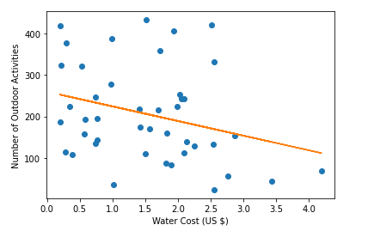
Water Cost (US $) vs Number of Outdoor Activities
The scatterplot shows that there is a weak negative correlation between the cost of a bottle of water and the number of outdoor activities a city has. The Pearson’s coefficient and R-squared indicate this too.
Pearson’s Correlation:
Correlation = -0.29
p-value = 0.056
R-squared: 0.09

Slide 16
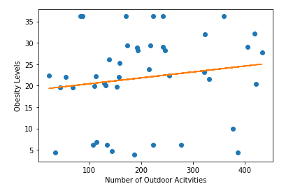
Is there a difference in the number of outdoor activities and obesity levels in a healthy city?
The p-value indicates that the significance is low so we can reject the null hypothesis that the number of activities and obesity levels are correlated.
Correlation: 0.15
R-squared: 0.02
Tested p-value: 0.165

Slide 17
obesity_level | WorkPerDay | SunshinePerDay | water_cost | outdoor_activity | pollution | life_expectancy | life_expectancy2 | R² ^{(Adj R2)}
Model 1 | 2.32 (0.001) | - | - | - | - | - | - | 0.227 (0.21)
Model 2 | - | 1.58 (0.71) | - | - | - | - | - | 0.055 (0.06)
Model 3 | - | - | 4.13 (0.024) | - | - | - | - | 0.118 (010)
Model 4 | - | - | - | 0.01 (0.35) | - | - | - | 0.021 (-0.003)
Model 5 | 2.71 (0.003) | 1.95 (0.015 | 6.49 (0.004) | 0.01 (0.297) | 0.05 (0.525) | -0.84 (0.023) | - | 0.51 (0.425)
Model 6 | 3.07 (0.001) | 2.11 (0.006) | 7.82 (0.001) | 0.01 (0.191) | -0.01 (0.928) | 8.65 (0.04) | -0.07 (0.026) | 0.576 (0.487)
Regression Analysis
Columns contain coefficient of determination (p-value)
Looking at the Adjusted R-squared for the variables they are all too low to indicate that the variables have any effect on obesity levels in a healthy city.

Slide 18
Conclusion
My findings after concluding the explanatory data analysis for the top healthiest cities in the world, do not show any correlations between the variables that are chosen and obesity levels in a city. More analysis on the other variables needs to take place to see if they help obesity levels.

